Slide 1
JCAD CORE User Group 21st & 22nd November 2017
Presenting :
Jackie Tims ☺
And Phil Walden

Slide 2
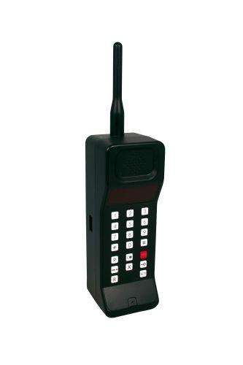
Good Morning - Points of order

Slide 3
Welcome
Agenda:
10.00am Arrival & Registration
10.15am Welcome and Introductions
10:30am Using Multiple Registers
11.00am Reporting
11.15am Break
11.30am Tips and Tricks
12.30pm Lunch
13.30pm CORE New Release 440
14:15 pm Networking and questions
14.45pm Conclusion & AOB & Survey Reponses
15.00pm Depart

Slide 4
Welcome and Introduction – Tues - Solihull
Company | Registers | Contact | E-mail
Anglian Water Group | Risk Financial Controls Covenants | Westwood Helena | hWestwood@anglianwater.co.uk
Bron Afon Community Housing | Risk | Jill Jones | jill.jones@bronafon.org.uk
Bron Afon Community Housing | Risk | Amanda Oliver | Amanda.Oliver@bronafon.org.uk
National Friendly | Risk | Martyn Love | martyn.love@nationalfriendly.co.uk
PSA Group | Risk | Sally - Anne Doyle | sallyanne.doyle@mpsa.com
PSA Group | Risk | Greg Pointon | greg.pointon@mpsa.com
Solihull Metropolitan Borough Council | Risk | Jane Tattam | jtattam@solihull.gov.uk
Sovereign Housing Group Ltd | Risk | Becky Tucker | Becky.Tucker@sovereign.org.uk
Sovereign Housing Group Ltd | Risk | Simon Beake | Simon.Beake@sovereign.org.uk

Slide 5
Welcome and Introduction – JCAD – What have we been up to
Damian – 7 triathlons, Moyleman off road marathon, Chichester half marathon
Adrian – Great South Run, Beachyhead Marathon, will be doing the London marathon 2018
Tim – dance and jive competitions
Jackie – signed up for the London marathon 2018 http://uk.virginmoneygiving.com/JackieTims
Simon Berry – Haslemere Dynamos FC
Phil – Wheatsheaf Pub FC
Catherine – will be performing with the dance company, Basingstoke tappers at the Haymarket Theatre in Basingstoke on the 17th December - http://www.basingstoketappers.co.uk/index.php

Slide 6
Welcome and Introductions - JCAD - Our focus
2015 /2016
2017 /2018
Completion of MOJ Portal integration
Completion of LACHS 5
Expansion & internationalisation of CORE
Enlargement of development team
Completion of JCAD website development
Specifically with reference to risk & compliance
Develop new markets to grow business
Develop and test hosted solution for LACHS
Roll out of LACHS V5
Completion of LACHS 5 CLOUD
Recruitment of Marketing Executive
Start redevelopment of CORE

Slide 7
Using Multiple registers
Risk – Operational and Strategic
Compliance
Audit Reports and Recommendations
Contracts
Document management
External Audit Shortfalls
Safeguarding Incident Register
Covenants Management
Financial Controls
Health and Safety Risk Assessments
ISO 27000, 31000
Examples Demo :-

Slide 8
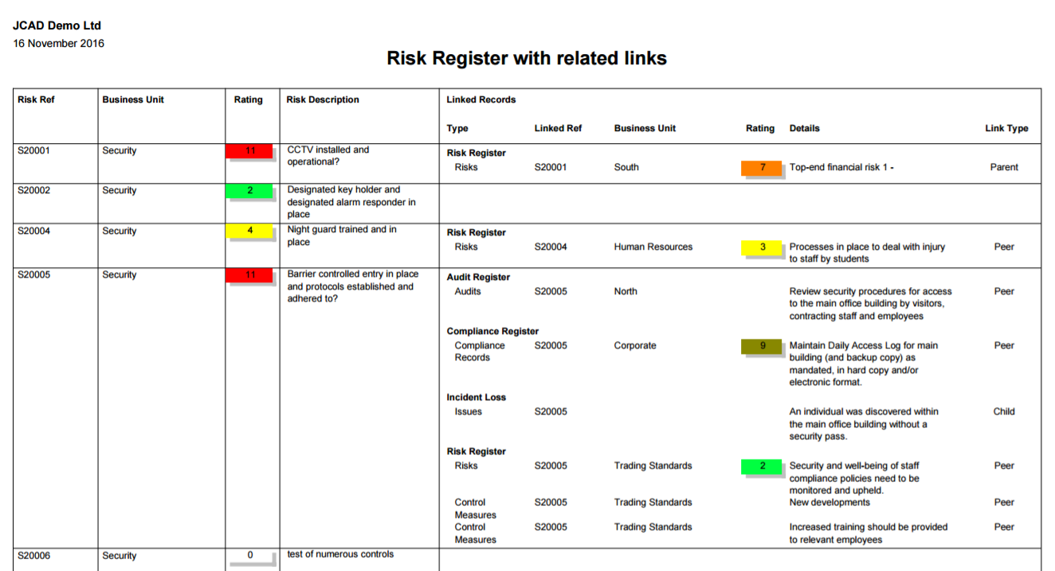
JCAD CORE – REPORTS – LINKED RECORDS

Slide 9
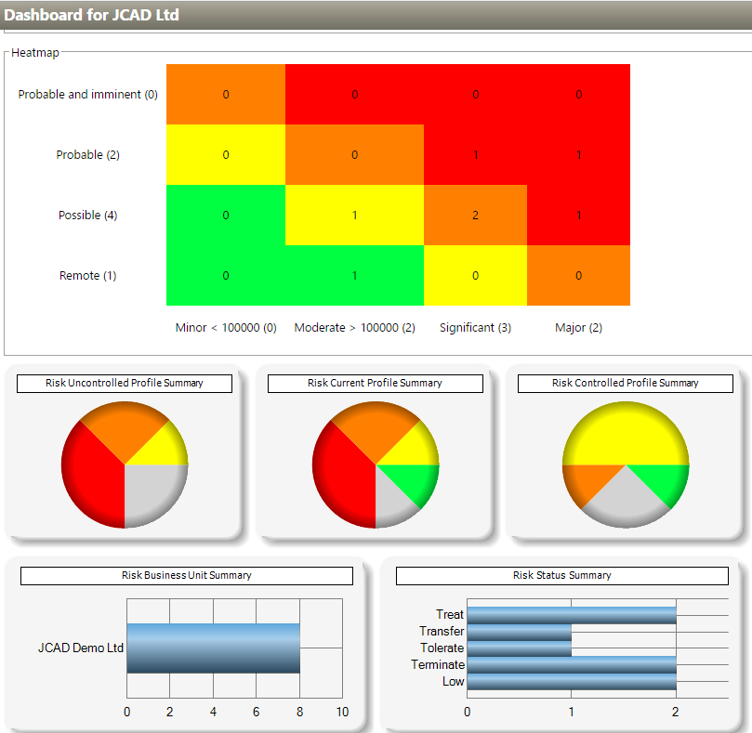
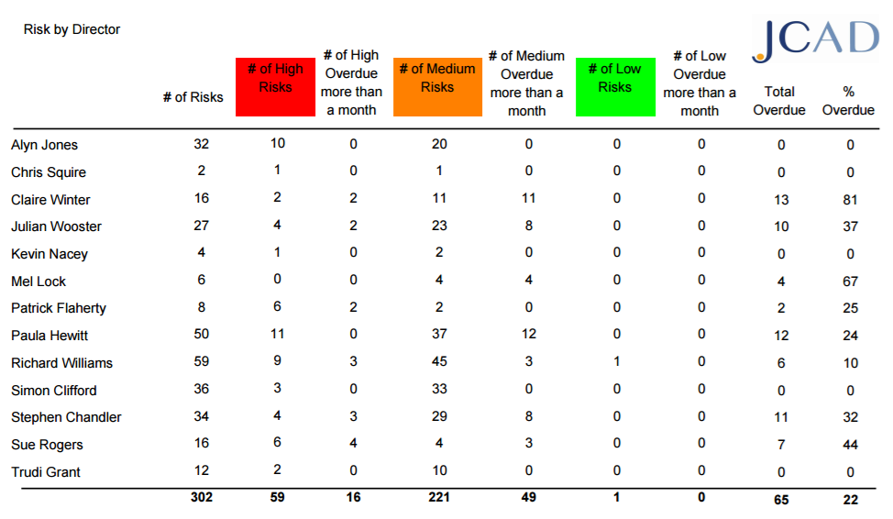
JCAD Reporting
Views
Crystal Custom Reports
Dashboard

Slide 10
JCAD CORE – REPORTS – RISKS BY DIRECTOR

Slide 11
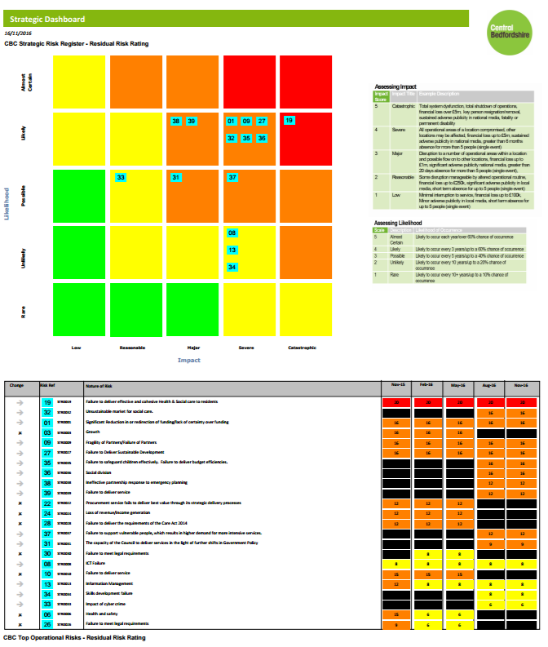
JCAD CORE – REPORTS – STRATEGIC REGISTER & Candidates

Slide 12
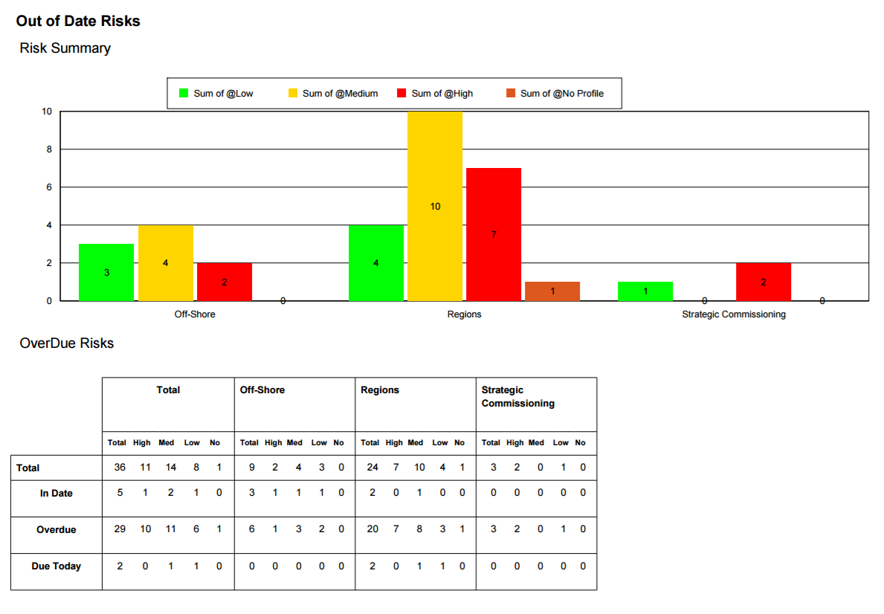
JCAD CORE – REPORTS – OVERDUE EXCEPTIONS

Slide 13
TIPS and TRICKS
In Progress Report Examples
Monthly change example.pdf
Summary Reprot.pdf
Find Business Units
Chrome Issue – Non issue after December ( Google Fix)
Integration with Active Directory or Azure
Crystal Report edit Module
Assurance solutions
Using Performance Management tables
THE HELP SCREENS
Any Other tips ?

Slide 14
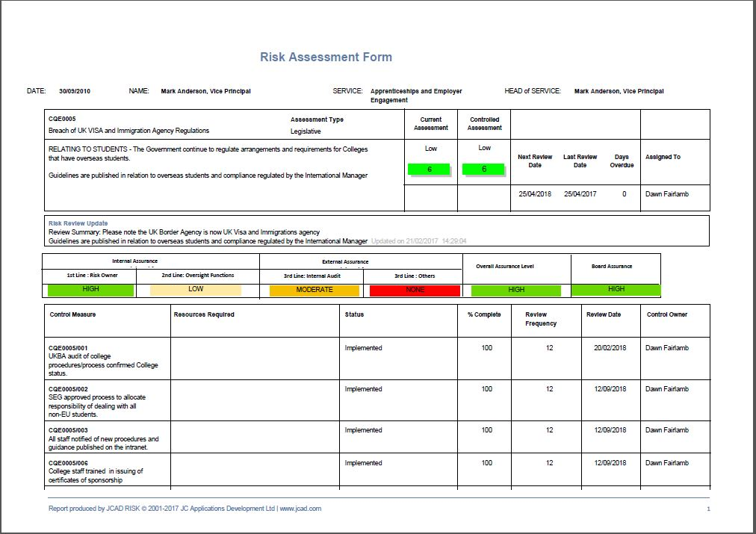
JCAD CORE – REPORTS – ASSURANCE
Assurance levels
Using Actions
Using PM

Slide 15
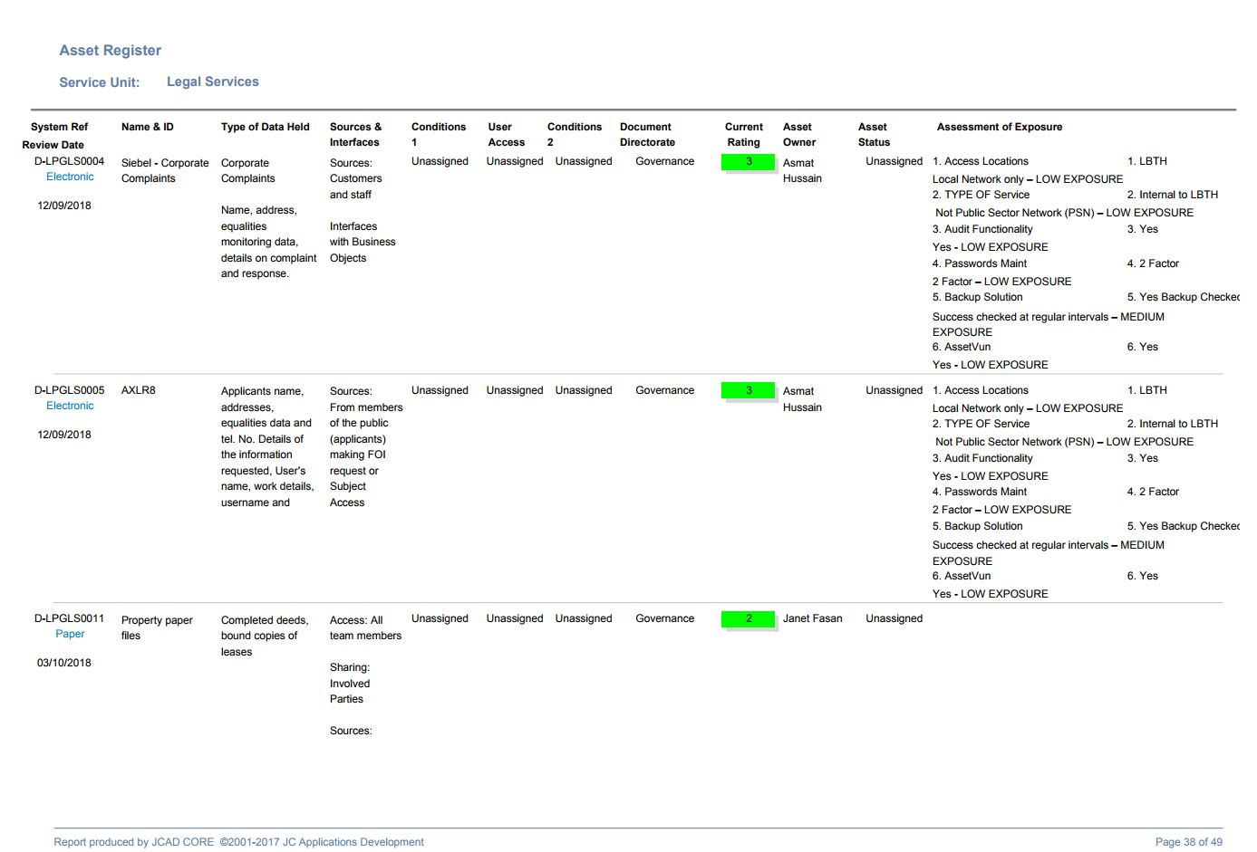
JCAD CORE – REPORTS – Using PM tables for Questionnaires
Using PMs
Custom Fields

Slide 16
LUNCH

Slide 17
JCAD CORE – Release 440
Views and report fields
White Text column headings
Added Review Comments ,Last Review Date , BU, Corp Plan and Project Descs, Control Template and Type
Diary event Assigned to corrected – previous listing Risk Owner on events
Show descendent Records On
Reviews
Complete Button with RAG colours
Review date calculation consistency button vs Review tab – Admin function to select
Review completion allowed > 99 days - > 999
Reporting
Assigned to “Is One of” – fixed
Users extract – corrected record types
Risk and Controls Forms
Multiple Impacts and Details Labels don’t fit – Text now wraps – Caveat – Form items move
Contacts selection – can use text search
Issue Add New Issue removed if register not online
Control details – Terminology settings corrected
Show descendants and crosscuts removed from BU details and KRI forms ( not relevant)

Slide 18
JCAD CORE – Release 440
Event Triggers
Control Target date added
Custom Filter box added ( like Approvals)
Risk Owner included for Control Triggers
Dashboard
Data groups only included switched on groups
Overdue graphs filter correctly
Misc & Admin
Illegal Characters trapped from Cut and paste
Edit previous KRI data entry
Copy on other Record type other than 1 – now creates review correctly
Delete a Document !!!
Admin maintenance –fields are the customized label ( where possible)
Possible Inclusions
Tool Tips – Soft Returns functionality
Admin tables – column resize
Forgotten Email address case sensitive
Unrestricted Proximity dates To < from
Chart Updates
BU Maintenance – Sentence case removed

Slide 19
Networking & Questions

Slide 20
Thank you
Thank you for joining us today ☺
We’d really appreciate it if you could complete the feedback form for us.

Slide 21
Welcome and Introduction – Weds - Essex
Company | Registers | Contact | E-mail
Anglian Water Group | Risk Financial Controls Covenants | David Jones | dJones3@anglianwater.co.uk
British Council | Top Risk Operational Risk | Philip Doig | philip.doig@britishcouncil.org
Essex County Council (fujitsu) | Risk Opportunities | Denise Abel | Denise.Abel@essex.gov.uk
Essex County Council (fujitsu) | Risk Opportunities | Ryan Morgan | ryan.morgan@essex.gov.uk
Essex County Council (fujitsu) | Risk Opportunities | Camilla Keen | Camilla.Keen2@essex.gov.uk
Essex Police, Fire & Crime Commissioner, Fire & Rescue | Risk | Helen O'Sullivan | helen.osullivan@essex-fire.gov.uk
Essex Police, Fire & Crime Commissioner, Fire & Rescue Authority | Risk | Miles Glover | miles.glover@essex-fire.gov.uk
General Pharmaceutical Council | Risk | Pascal Barras | Pascal.Barras@pharmacyregulation.org
General Pharmaceutical Council | Risk | Bobbi Birk | Bobbi.Birk@pharmacyregulation.org
Hertfordshire County Council | Risk | Peter Stanley | peter.stanley@hertfordshire.gov.uk
Hertfordshire County Council | Risk | Steve Doherty | Steve.Doherty@hertfordshire.gov.uk
Kent County Council | Risk | Sharon Crampton | Sharon.Crampton@kent.gov.uk
Kent County Council | Risk | Mark Scrivener | mark.scrivener@kent.gov.uk
Luton Borough Council | Risk | Gloria Johnson-Ashman | Gloria.Johnson-Ashman@luton.gov.uk
Redbridge LBC | Risk H&S Risk Assessments Schools Risk | Satinder Sidhu | Satinder.Sidhu@redbridge.gov.uk
Waltham Forest LBC | Risk | Andrea Nitschke | Andrea.Nitschke@walthamforest.gov.uk
Waltham Forest LBC | Risk | Corrina Young | corrina.young@walthamforest.gov.uk

